Slide 1
Smart Irrigation Control in Commercial Greenhouse Facilities

Slide 2
PROBLEM STATEMENT:
Water efficiency in greenhouses boosts yield and sustainability. Soil Moisture and DHT11 sensors provide real-time soil and climate data. Cloud-based ML models analyze this data to adjust irrigation schedules. Data analytics tools offer moisture trend visualization, water consumption forecasting, and optimal scheduling insights. This results in smart irrigation and better crop outcomes.

Slide 3
SENSORS USED:
Soil Moisture (1)
DS18B20(1)

Slide 4
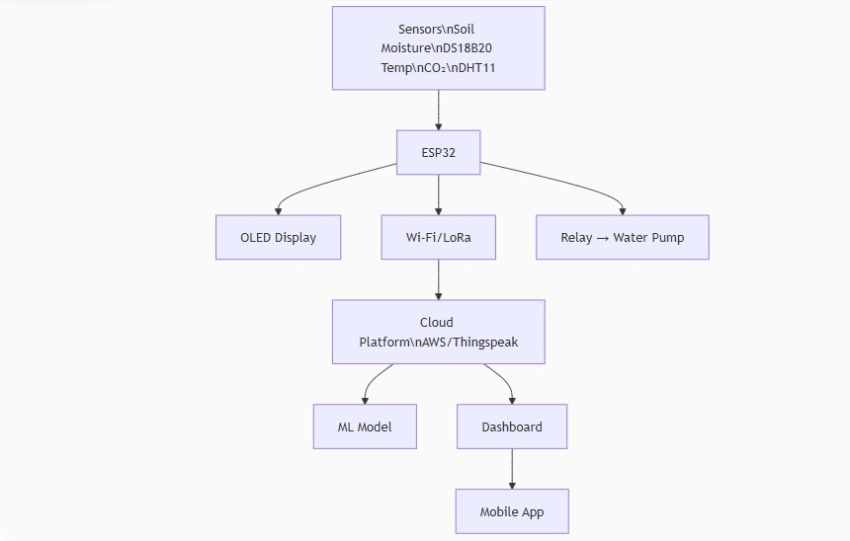
FLOW DIAGRAM:

Slide 5
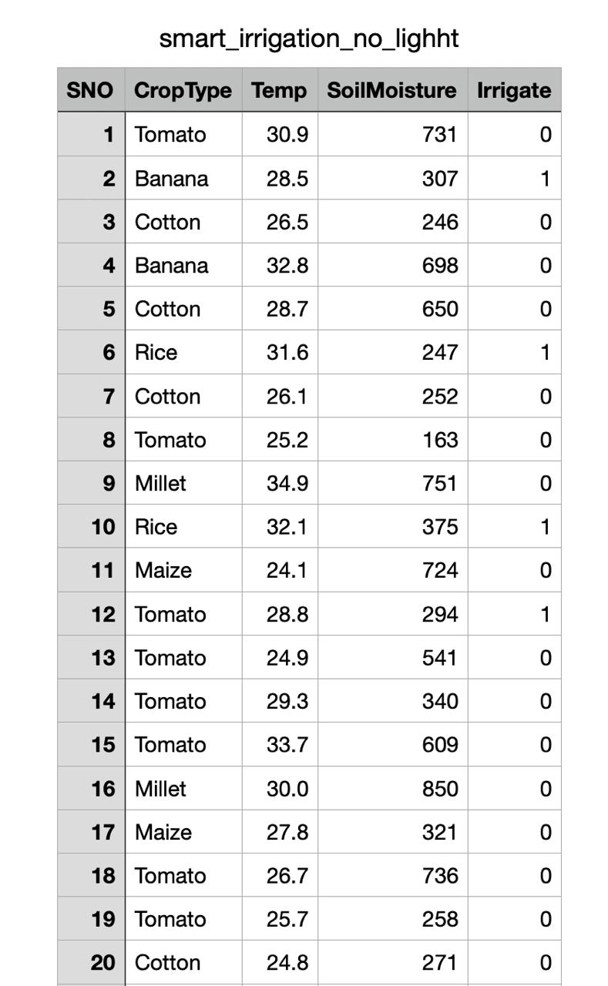
DATA SET:

Slide 6
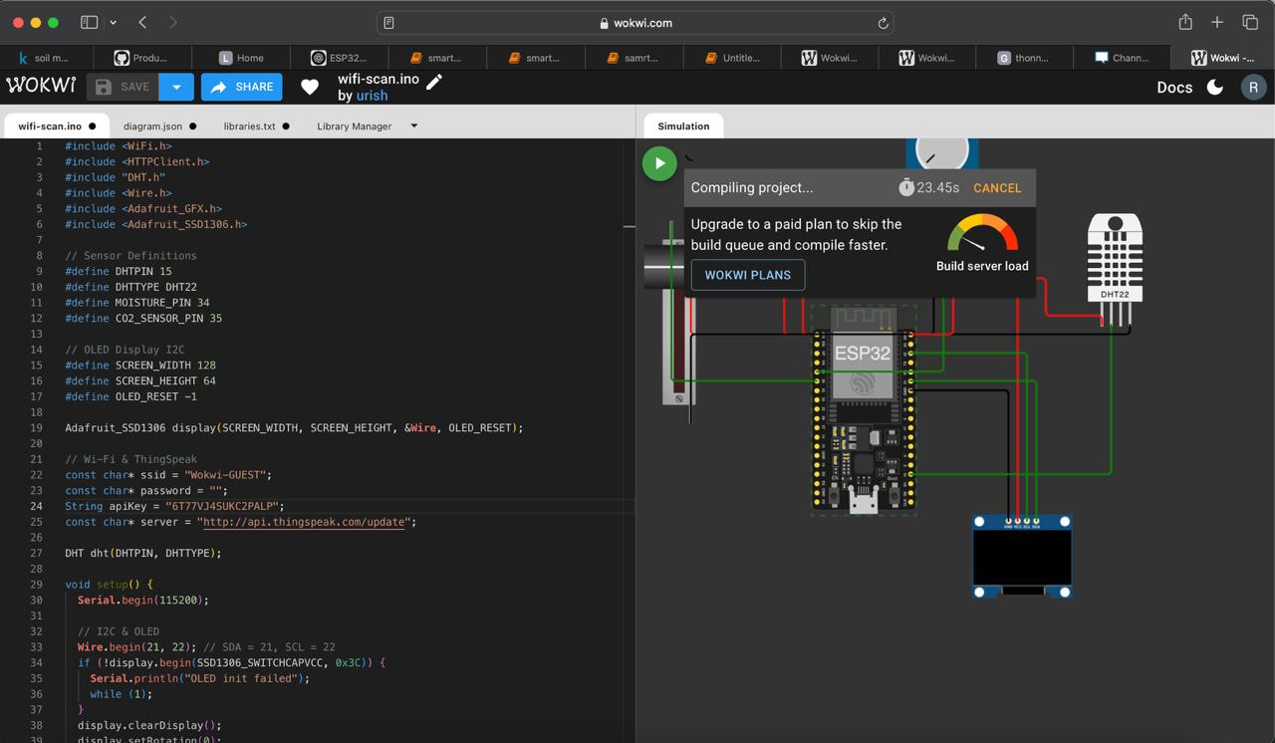
SIMULATION

Slide 7
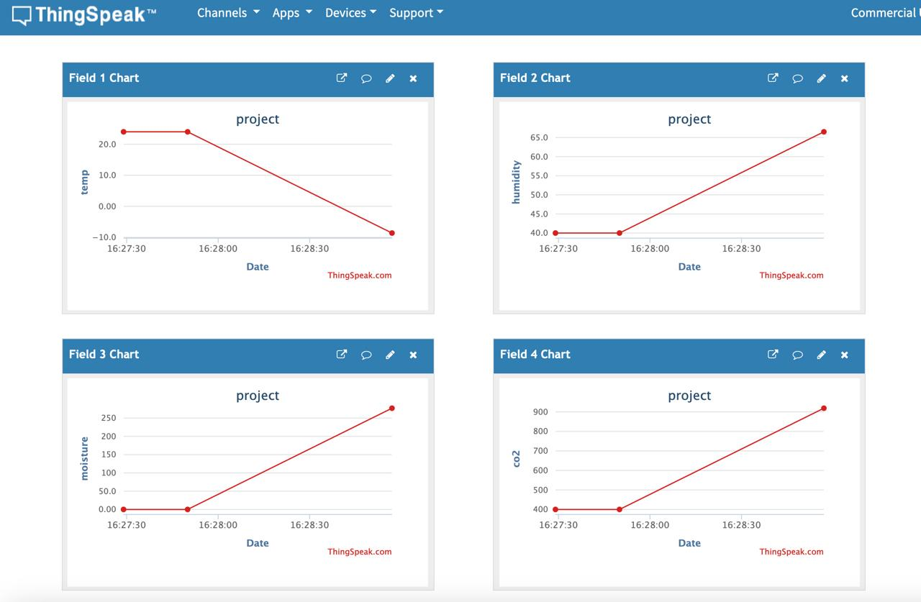
THING SPEAK OUTPUT:

